Slide 1













Chatbot for Song Recommendation System
Final Project
Presented By
Dinesh Karthik A
711721244014
III Btech CSBS
KGiSL Institute of Technology
3/21/2024 Annual Review
1

Slide 2




PROJECT TITLE
Innovative song recommendation system designed to cater to individual music tastes and preferences. By leveraging advanced algorithms and user input, HarmonyHub analyzes listening habits, genre preferences, mood indicators, and more to curate personalized playlists and song suggestions
3/21/2024 Annual Review
2

Slide 3




AGENDA
1. Problem Statement
2. Project Overview
3. End Users
4. Solution and Value Proposition
5. The Wow Factor in Your Solution
6. Modelling
7. Results
3
3/21/2024 Annual Review

Slide 4

PROBLEM STATEMENT
Despite the vast amount of music available today, users often struggle to discover new songs that resonate with their tastes and preferences.
Existing recommendation systems may not always provide accurate or personalized suggestions, leading to frustration and wasted time searching for the right music
3/21/2024 Annual Review
4

Slide 5

PROJECT OVERVIEW
The goal of this project is to develop a sophisticated song recommendation system that addresses the challenges faced by users in discovering new music that aligns with their individual preferences.
The system will employ cutting-edge machine learning algorithms, collaborative filtering techniques, and user interaction data to generate highly personalized song recommendations.
3/21/2024 Annual Review
5

Slide 6

WHO ARE THE END USERS?
Music enthusiasts: Individuals who are passionate about exploring new music and discovering songs that align with their tastes and preferences.
Streaming platform subscribers: Users of music streaming platforms who rely on recommendation systems to discover new music and create personalized playlists.
Casual listeners: People who enjoy listening to music for leisure and entertainment purposes, seeking recommendations to enhance their listening experience.
Music industry professionals: Artists, producers, and music curators who use recommendation systems to understand user preferences, trends, and behaviors for content creation, curation, and marketing purposes.
3/21/2024 Annual Review
6

Slide 7

YOUR SOLUTION AND ITS VALUE PROPOSITION
Our solution is a sophisticated song recommendation system that leverages advanced machine learning algorithms and user interaction data to provide highly personalized music recommendations.
By analyzing user preferences, listening habits, mood indicators, and contextual information, our system generates tailored song suggestions that resonate with each individual user.
3/21/2024 Annual Review
7

Slide 8

THE WOW IN YOUR SOLUTION
Ultra-Personalization: Our system dives deep into users' preferences, mood, and context, delivering recommendations that feel tailor-made for each individual, resulting in a highly immersive and satisfying music discovery experience.
Adaptive Intelligence: Continuously learning from user interactions, our system refines recommendations over time, ensuring they stay relevant and engaging as users' tastes evolve, while still offering delightful surprises to keep them excited about discovering new music.
Seamless Integration: With transparent and trustworthy recommendation processes seamlessly integrated into existing music platforms, users can effortlessly enjoy personalized music recommendations wherever they go, enhancing their overall listening experience with minimal effort.
3/21/2024 Annual Review
8

Slide 9
MODELLING
Recurrent Neural Network (RNN) architecture, sequential dependencies in music data are captured, allowing for the generation of coherent music recommendations. The model utilizes dense embeddings to represent songs, capturing nuanced relationships between musical elements and enhancing recommendation accuracy.
To predict the next song in a sequence, the model is trained on a diverse set of user listening histories and music metadata. Iterative learning improves the model's ability to generate relevant and engaging music recommendations.
Regularization techniques and hyperparameter tuning are employed to optimize model performance, ensuring dependable and high-quality music recommendations tailored to individual user preferences.
3/21/2024 Annual Review
9

Slide 10
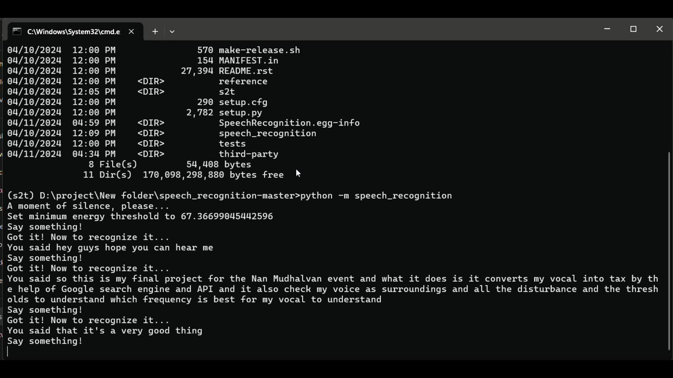
RESULTS
VIDEO LINK
3/21/2024 Annual Review
10

